Slide 1
Repak Membership - Introduction
Compliance with Packaging Regulations
QF 509 v1

Slide 2
About Repak Membership
- Introduction to Repak & EU Regulations
- Membership Benefits & Scheme Rules
- Invoicing, Submission Dates & Fee Rebate
Statistical Training for Packaging Returns
- Membership Checklist -Training Report Generated
- Shared Responsibility
- Packaging Terminology
- Guidance on Materials & Back Door Packaging Waste
- Contract Packing Reporting
- Report Form – Understanding Layout

Slide 3
Post Training Report
New/Joining members - following the training a post training report will be emailed to attendees including notes from discussion outlining:
Membership Checklist.
Business Activity in the ROI.
Guidance on where you report on the Repak form.
Next Steps to progress a submission for review and approval.
Existing members – a post training email will be emailed with links to resources and a copy of the training presentation on the Repak website.
-
-

Slide 4
Introduction to Repak
Repak was set up in 1997 to help Member businesses meet their legal obligation to recycle the packaging they place on the Irish market.
We have over 3,400 Members, whose fees fund household recycling bins, bottle banks, civic amenity sites and business back-door waste nationwide..
Over the past 20 years, Repak has grown from a ‘compliance scheme’ to a leading environmental organisation that has helped transform the recycling landscape in Ireland, providing credible knowledge and expertise to many stakeholders on packaging waste, while supporting our Members.

Slide 5
Benefits of Membership
Account Manager
Members’ Plastic Pledge
Prevent & Save Programme
Packaging & Design Guide for the Circular Economy
Back Door Waste Audit
Access to a Packaging Technologist
Free Member Webinars & Statistical Return Training
Annual Pakman Awards
Further information and access to marketing resources available at the Members Media Hub on the Repak website.

Slide 6
EU Packaging & Packaging Waste Directive
The EU Packaging & Packaging Waste Directive requires the recovery of specified packaging waste, imposing obligations and declaration responsibilities on all Major Producers.
Major Producers are :
Businesses that have an annual turnover greater than €1m (ex VAT);
and who place/supply 10 tonnes* of Packaging Material, Packaging or Packaged products on to the Irish market.
* Contract packing activities and Consignment activities contribute towards the 10 tonne threshold.
An up-to-date list of Repak Members can be found on our website.

Slide 7
Contract Packing Activities
A business is a ‘Contract Packer’ if they engage in any of the following activities in ROI –
Manufacture and/or pack goods for another ROI business
Pack or repack goods on behalf of another ROI business
Provide 3rd Party Logistics fulfilment services in ROI (Warehousing + pick/pack)
Contract Manufacture for another ROI business
Apply packaging to goods In ROI that they do not own
2 types:
You own the brand and have goods packed by another ROI business
You provide contract packing services
Note: Where contract packing activities take place outside ROI the Importer has the reporting obligation.
Contract Packing covered in more detail later in presentation.

Slide 8
Repak Scheme Rules
As part of the Application & Registration Process each member signs and agrees to operate within the Repak Scheme Rules.
Scheme Rules - key points to note:
Submission of bi-annual packaging data on time (21st August + 21st February).
Payment of invoices on time (30 days).
Retention of records (7 Years).
Submissions are sole basis of invoice (subject to minimum fee).
Based on self-certification and subject to Audit by Repak.
Repak may revoke a membership account if any of the above criteria are not provided to Repak in line with the membership terms and conditions.

Slide 9
Repak Scheme Rules
Packaging returns submission dates.
Half 1 January-June statistics submitted by 21st August each year.
Half 2 July-December statistics submitted by 21st February of the following year.
Invoicing.
Two invoices issued per year in January (Half 1) & July (Half 2).
- Half 1 2023 Membership fees are based on Half 1 2022 packaging data
- Half 2 2023 Membership fees are based on Half 2 2022 packaging data
.
Payment terms.
30 days from date of invoice.
Supplier Set-up Forms must be provided if required.
PO numbers must be supplied if required.
Reporting Packaging Weights.
Report in Metric Tonnes (1,000kg) and to 3 Decimal Places (nearest kg).

Slide 10
Making your first Repak Return
New members joining will be required to:
Gather their packaging data for the previous calendar year.
Use the Repak Packaging File provided to complete their first return
- Further support is available to help input data.
Submit the packaging return within 4-6 weeks following training.
Registration & Compliance is only achieved once all data is submitted and
invoices are paid.
Certificates of Compliance are issued when the joining account is up to date.

Slide 11
Reporting Portal – making your packaging submissions.
Repak will send you an email inviting to you set up login credentials for the reporting portal.
Click on the link in the invitation email to set up your Username and Password.
2FA enabled - when you enter your username & password a 6-digit code is emailed to you.
Preferred browsers are Google Chrome and Microsoft Edge.
Repak Portal https://repaklive.powerappsportals.com/rols/
Full support is available to assist in accessing the portal and submitting your packaging data.

Slide 12
Eco Fee Modulation for Packaging
Eco fee modulation – part of the EU Waste Framework Directive.
- One of the key tools is the Eco-modulation of Extended Producer Responsibility (EPR) fees.
Linked to net cost of waste management and will change depending on these costs.
- Eco-modulation of fees introduced to improve the recyclability of and to incentivise the eco-design
of products.
Net cost of handling materials that are not recycled is higher than for materials that are.
- From a packaging perspective, under Eco fee modulation, non-recyclable packaging will command
higher EPR fees than packaging materials that are recyclable across Europe to schemes such as Repak.
Eco fee modulation is fully rolled out for Plastic & Composite packaging and in progress
for all other packaging materials.

Slide 13
Fee Rebate
Fee Rebates were introduced in 2015 and details are communicated from the Membership
Department each half year depending on Repak’s financial performance.
Regular members qualify for each Rebate by:
Submitting packaging statistics on time (by 21st August & 21st February).
Paying the corresponding invoice on time i.e. 30 days from invoice date.
Having bank account details registered on the member portal.
The Rebate is paid direct to your nominated bank account by SEPA transfer.
Where the member has met all the qualifying criteria, bank details are required for this payment to be processed.

Slide 14
Member Statistical Training - Guidance
Guide on how to complete your Repak Packaging Return

Slide 15
Packaging Terms
What is Packaging?
Packaging is any material used for the containment, transport, handling,
protection, marketing or sale of an item.
All types of packaging to be reported to Repak.
Primary
Secondary
Tertiary (transport)

Slide 16
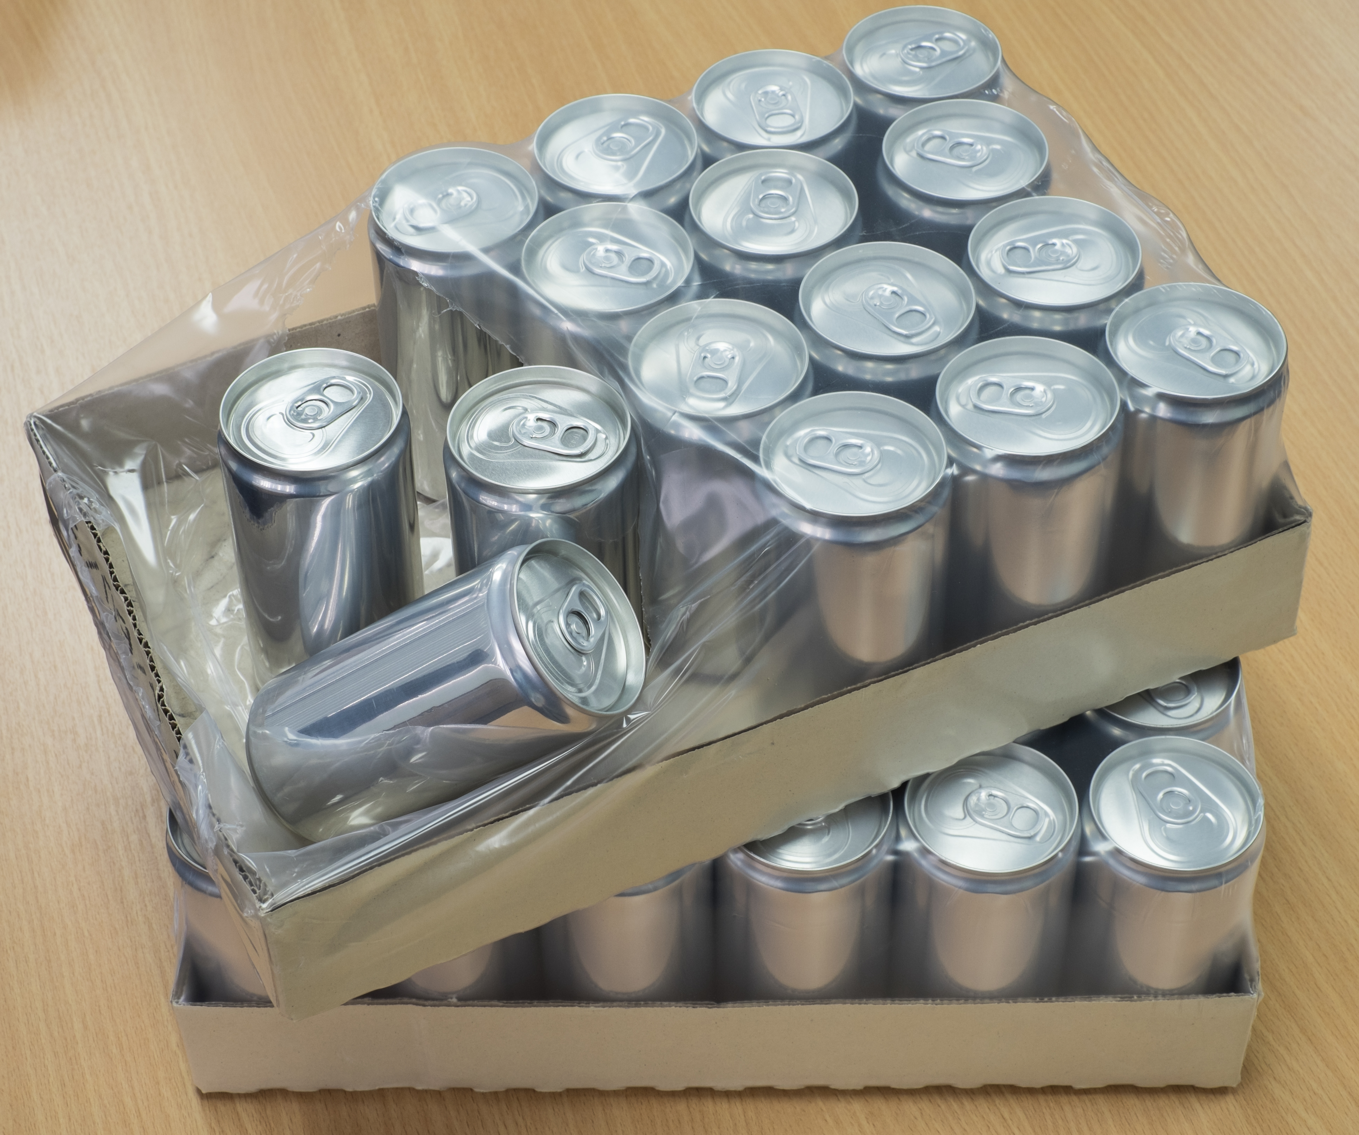
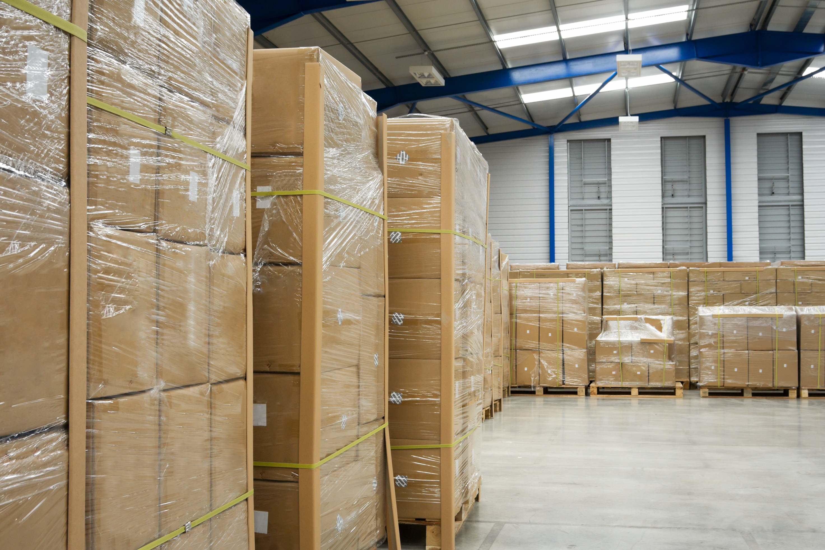
Primary Packaging
This is sales packaging; the packaging that is right next to the product and you often can’t sell the product without primary packaging.
Secondary Packaging
This is the packaging that binds a number of primary units together, or outer wrapping that assists in displaying, storing, shipping and protecting products.
Tertiary Packaging
This is the transport packaging used to transport and protect the goods for storage and shipping.

Slide 17
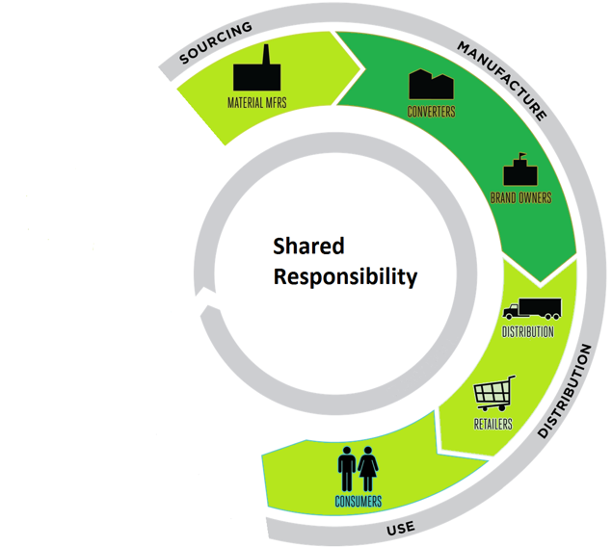
Shared Responsibility – The Packaging Life-Cycle
The Repak fee structure is based on the principle of Shared Responsibility.
This ensures the cost of recovery & recycling of packaging waste is spread across all participants of the packaging supply chain.
Members are charged depending on:
the quantity & type of packaging handled and placed on the market
their position(s) in the packaging supply chain / life cycle.
Upward Resonance: a rolled-up obligation whereby the importer pays for stages which took place outside ROI. As the parties responsible for these stages have no obligation under the Irish Regulations, the importer automatically takes on the obligation (applied in Section 2.3 (Imported Output Packaging).

Slide 18
Shared Responsibility – The Packaging Life-Cycle
The 5 stages of Responsibility
1. Material Manufacturer
- Makes materials or imports materials that will be used to make packaging.
2. Converter
- Makes packaging or imports empty packaging
3. Brandholder / Importer*
- Owns the brand name, applies packaging or imports packaged/finished product.
4. Distributor
- Automatically report as ‘Distributor’ for all the packaging and packaged
product reported on the Brandholder/Importer line.
5. Retailer
- Report as the Retailer for any packaging your customer removes.
* Importer = the first ROI business to charge ROI VAT for the goods.

Slide 19
Material Types
Additional guidance see the Repak
‘Packaging & Design for the Circular Economy’
Guide to the Challenges & Opportunities in Irish Packaging Recycling

Slide 20
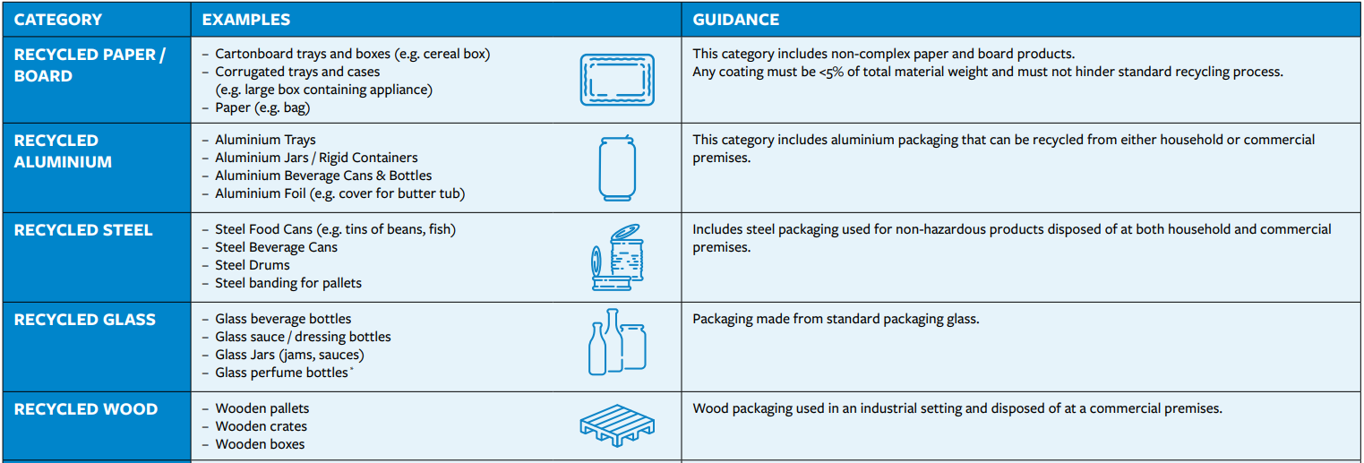
Materials that can be Recycled in Ireland (excl. Plastics)
Source - ‘Packaging & Design for the Circular Economy’ (Recycled = Currently Recycled)

Slide 21
Materials that are not Recycled in Ireland (excl. Plastic)
Source - ‘Packaging & Design for the Circular Economy’

Slide 22
26
Composite Packaging (Mixed Material)
A packaging type that is made up of more than one material that is not
mechanically/easily separable.
If the main material weighs less than 95% of the overall weight, report as composite.
If the main material weighs more than 95% report all as the main material.
Source - ‘Packaging & Design for the Circular Economy’ Recycled = Currently Recycled
Contaminated/soiled packaging is not recycled.

Slide 23
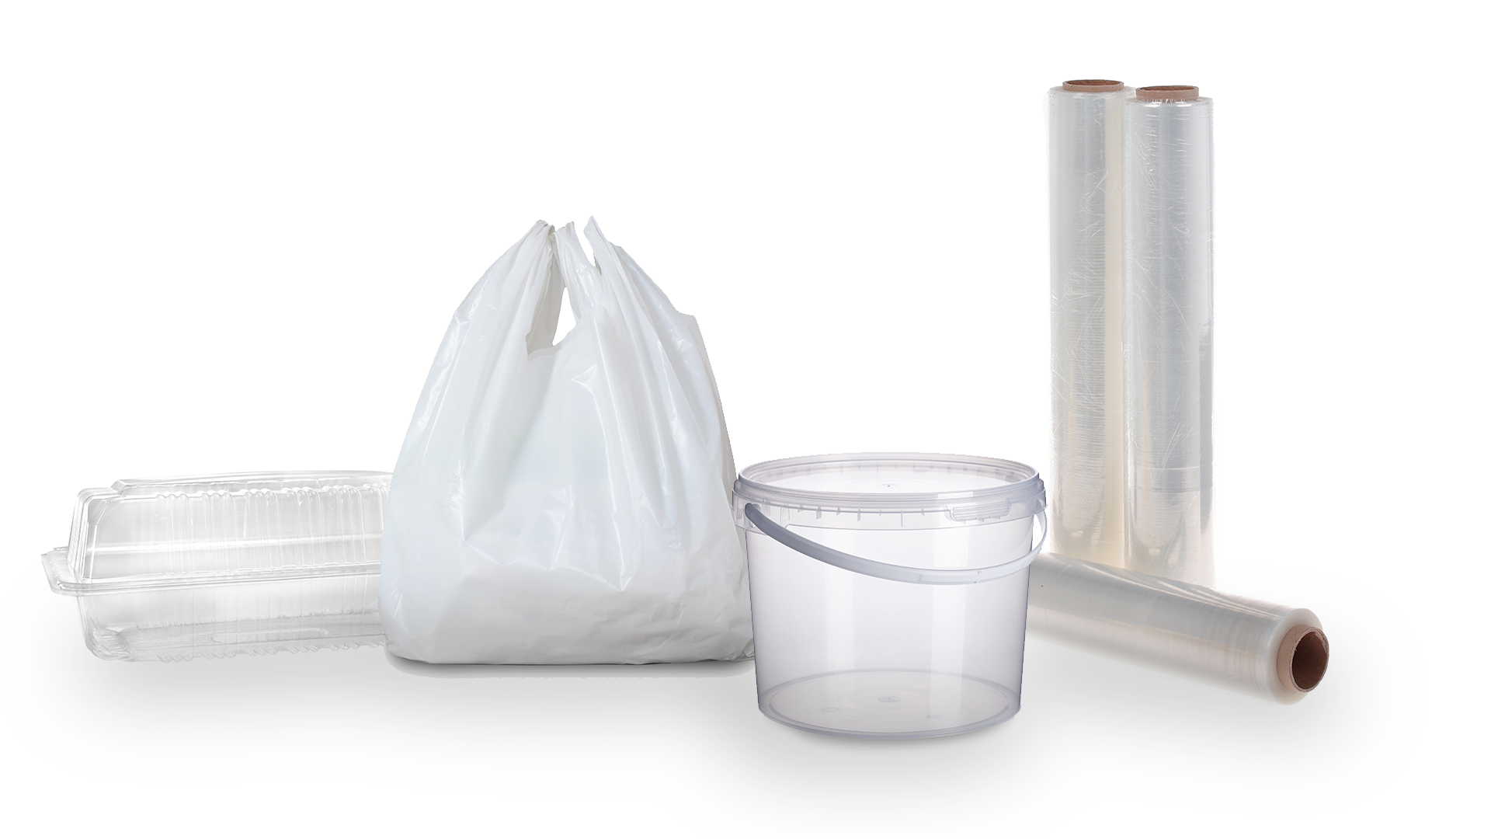
Plastic Packaging
Plastic reported at the Brandholder/Importer level (sections 1.2 and 2.1 / 2.3) is required to be split under the following sub-categories:
Source - ‘Packaging & Design for the Circular Economy’ Recycled = Currently Recycled
Contaminated/soiled packaging is not recycled.

Slide 24
Single Use Plastic (SUP) Directive
The SUP Directive has a number of implications for producers.
As a result of the SUP Directive a number of plastics were banned in Ireland in July 2021 (plastic straws, plastic cutlery, expanded polystyrene cups and food containers).
You are obligated under the SUP Regulations if you place SUP items on the Irish market, regardless of the amount/weight of items.
This covers both packaging and non-packaging items.
4. More information and registration see Single Use Plastic for Members | Repak
Any queries regarding SUP can be sent to sup@repak.ie

Slide 25
Plastic Bottle Packaging
Plastic Bottles reported at the Brandholder/Importer level (sections 1.2 and 2.1 / 2.3) is required to be split under the following sub-categories:
Source - ‘Packaging & Design for the Circular Economy’

Slide 26
Packaging Terms & Definitions

Slide 27
Is your packaging ROI* sourced or Imported?
When reporting your packaging/packaged product you must report it as ROI sourced or Imported.
To identify packaging/packaged product as ROI sourced in Section 1 or Section 2 of the report form both of the following criteria must be met by your suppliers:
Suppliers must be a Limited Company with an ROI Companies Registration Office (CRO) number issued by the www.cro.ie ,
And
2. Suppliers must be a Limited Company with an ROI VAT number (with prefix IE followed by eight
followed by eight characters/digits) issued by www.revenue.ie
Packaging/Goods supplied by another business that does not meet the above criteria should be reported as Imported in both Section 1 and 2 of the Repak form.
This clarification of the rules will be effective from Half 2 (July-December) 2023 reporting due on or before 21st February 2024.
Please contact us if you need clarification/assistance in identifying the source of your packaging.
* ROI = Republic of Ireland (excluding N. Ireland).

Slide 28
Report Form
Input Packaging -
Reported in Section 1 of the form
Packaging which is removed from supplied goods or raw materials.

Slide 29
Considerations in preparing your report.
Section 1 – Input Packaging
Where does your packaging or packaged goods come from?
- ROI sourced or Imported
Do you have packaging waste arising on your premises
i.e. back door packaging waste?
What raw materials do you use?
How are they received/what packaging do you remove?
Do you return any packaging to your suppliers?

Slide 30
Section 1 - Input Packaging
1.1 Irish Sourced Input Packaging
Column 3 of 1.1 - Total tonnes removed from your branded products excluding reuse packaging = packaging removed from contract packed goods for your brand.
1.2 Imported Input Packaging
1.3 Internal Packaging Waste Management
- What happens to this waste / How is it disposed of?
(1.1 & 1.2 normally equals1.3 unless reporting reuse tonnes).
Note: Waste being backhauled out of ROI is required to be reported in Section 1 Input Packaging.

Slide 31
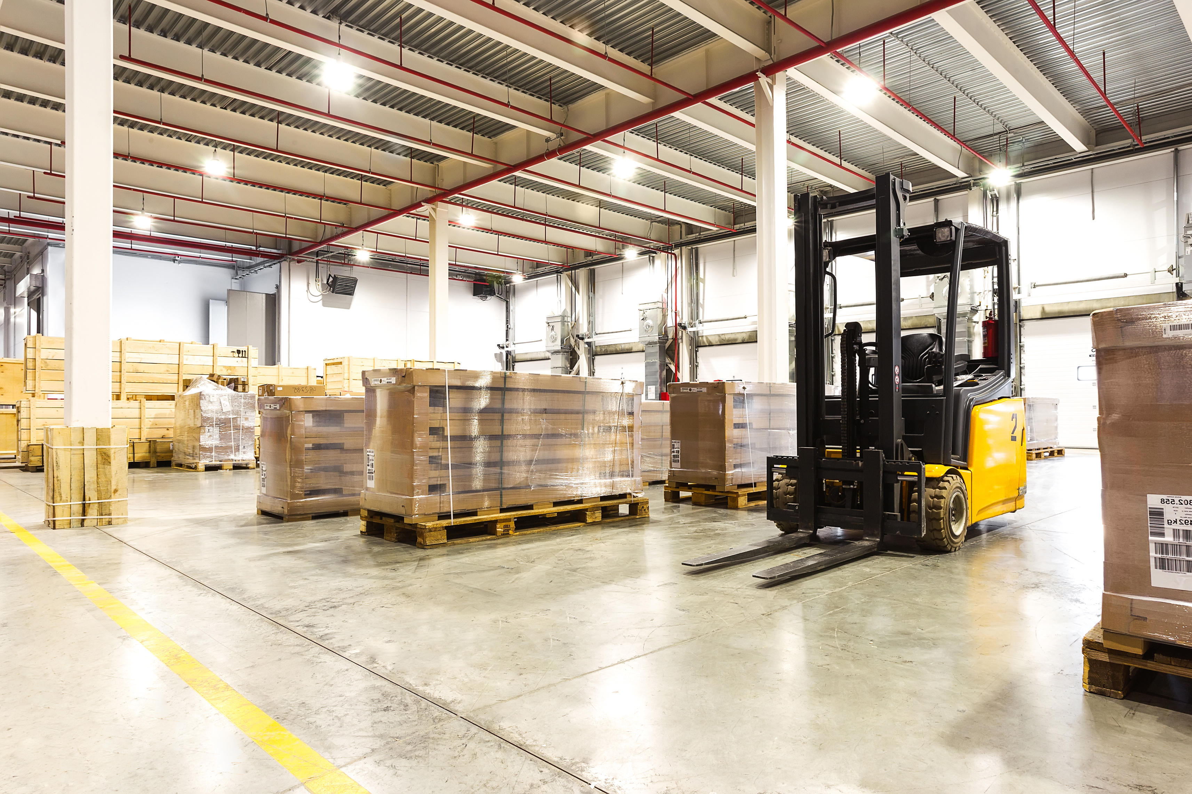
Report Form
Output Packaging -
Reported in Section 2 of the form
Empty/Filled packaging that is supplied to your customers i.e. placed on the market.

Slide 32
Considerations in preparing your report.
Section 2 – Output Packaging
How do you pack goods/products and what types of packaging do you apply?
- ROI sourced or Imported
Do you sell pre-packaged/finished goods/products?
Does your customer remove packaging and return it to you for reuse?
Do you sell to the end user?
Do you contract pack for a ROI business or does a 3rd party in ROI contract pack for you?

Slide 33
Section 2 - Output Packaging
2.1 Irish Sourced Output Packaging
2.3 Imported Output Packaging
2.2 & 2.4 All exports

Slide 34
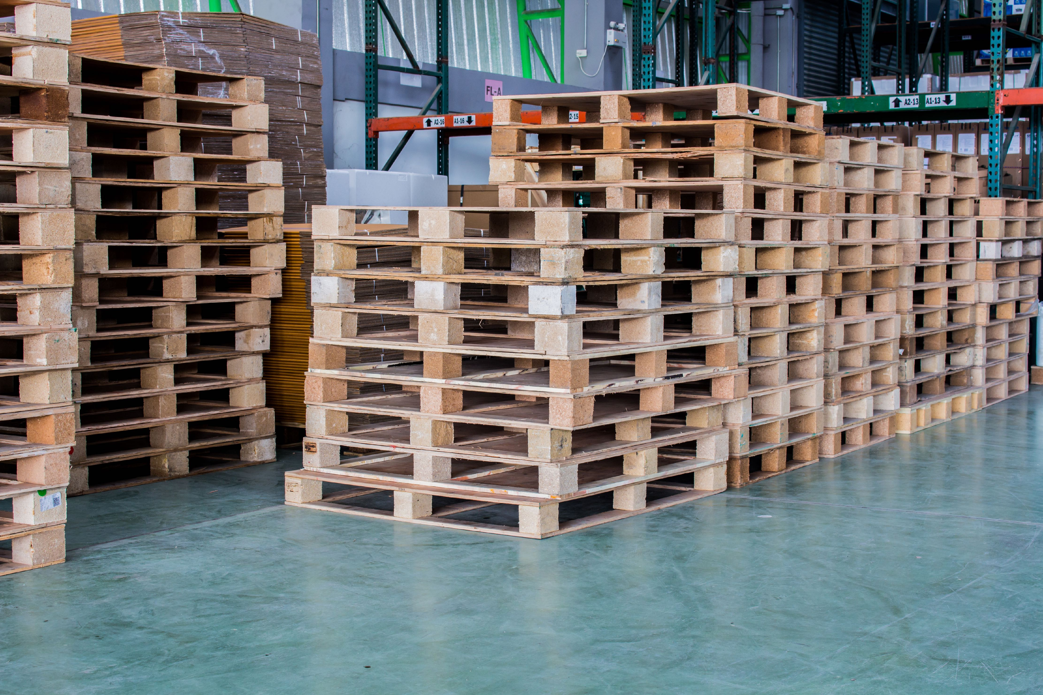
Two Types of Reuse
Official / Closed Loop Reuse
Onward Reuse
Packaging must be:
- conceived and designed for reuse
- make a minimum of 2 rotations
- documented system
Packaging is:
- removed from products/goods received
- reused on products sent to your customer
- not returned to you.
Pallets from recognised pallet rental schemes are to be excluded from your packaging report data e.g. CHEP, LPR.

Slide 35
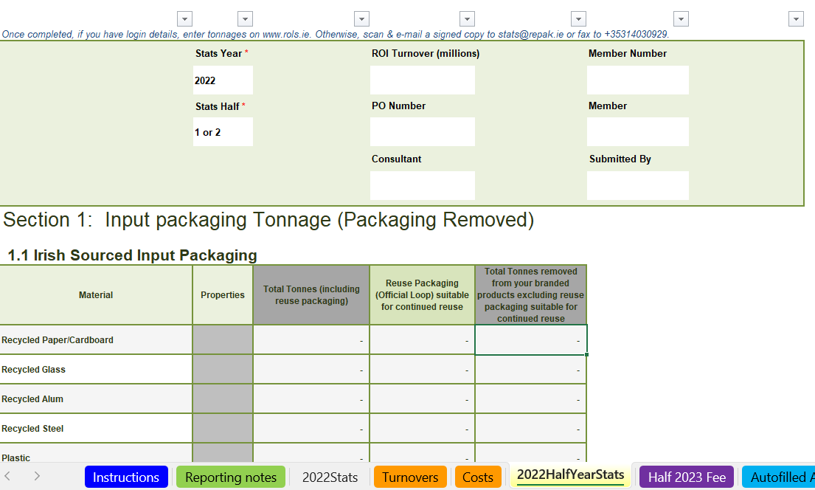
New Member Packaging File
Excel file to be completed as part of Registration.
Calculation of fees can be seen once figures are entered.
A fully completed form needs to be submitted to Repak for approval before final costs can be determined.
Reporting Broken into 2 Main Sections.
Shared Responsibility of fees.
Packaging needs to be identified as
- Irish Sourced
- Imported

Slide 36
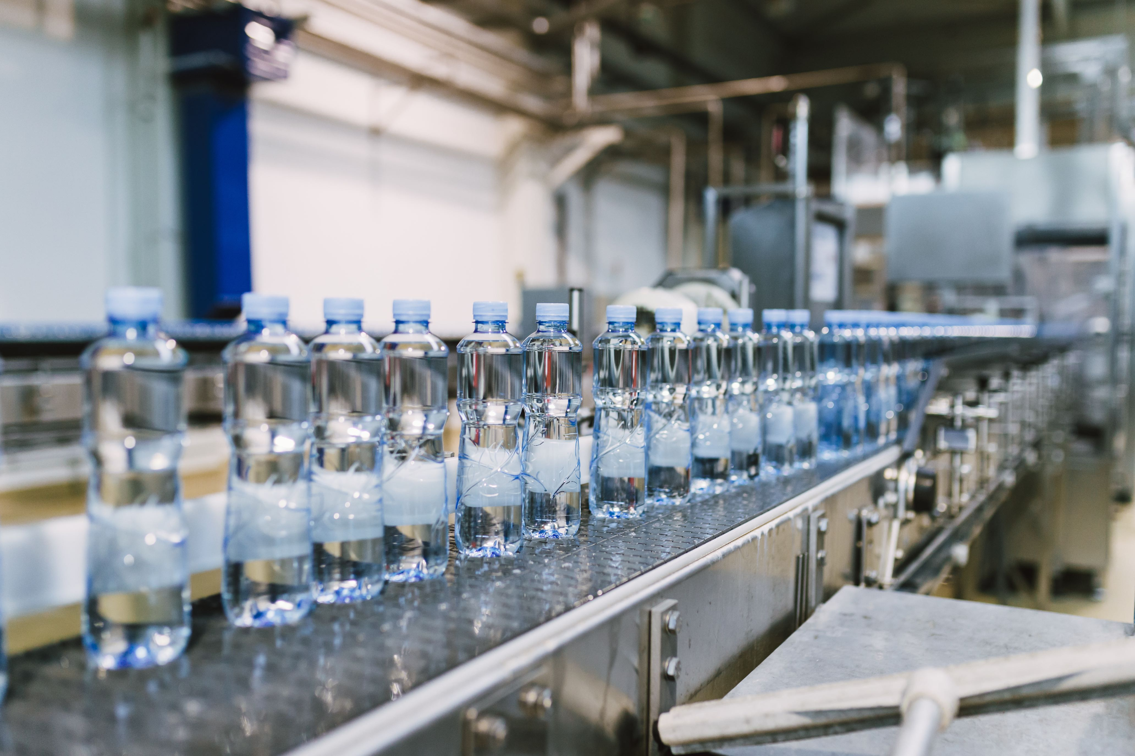
Contract Packing
The following rules apply to your business in relation to the reporting of packaging associated with contract packing activities if you:
Currently avail of the services of a contract packer based in the Republic of Ireland (ROI)
and/or
- Currently provide contract packing services to another business located in the Republic of Ireland (ROI).
Contract Packing activities counts towards the 10 tonne threshold.

Slide 37
A Business is a Contract Packer when they …
Manufacture and/or pack goods for another ROI business
Pack or repack goods on behalf of another ROI business
Provide 3rd Party Logistics fulfilment services in ROI (e.g. warehousing & pick/pack).
Contract Manufacture for another ROI business
Apply packaging to goods in ROI that they do not own
Do you meet any of the above criteria?

Slide 38
Contract Packing
If you are the Contract Packer or if you have a business Contract Packing for you.
To determine if you are above the annual threshold you must include all packaging activity carried out by you or on your behalf in your assessment.
Note:
The Contract Packer is financially obligated for all goods packed for any non-Repak Member.
If the Contract Packer is not a member of Repak the Brandholder reports all Inputs and Outputs.
A list of Repak Members can be found on our Member List on our website.

Slide 39
My Business Provides Contract Packing
You must report all Back Door packaging waste in Section 1 of the report form (split by origin as Irish Sourced and Imported).
This will include:
All packaging removed from raw materials received that arise at your locations.
All packaging removed from empty packaging received (from both your own packaging and other brands packaging).
Any empty packaging applied to your own manufactured goods - branded or plain*.
Any empty packaging applied* where your customer is not a member of Repak.
For 3PL services - All the existing primary and secondary packaging. Then also all the transport packaging you apply for another business that is not a Repak member.
* applies to primary, secondary and transport packaging.

Slide 40
Contract Packing – Where to Report on the Repak Form
All Input packaging is reported in Section 1.
Any packaging applied by the contract packer that will be removed by the customer (brandholder) as backdoor waste is reported by that customer on the third line of Section 1.1
- Total Tonnes removed from your branded products
excluding reuse packaging suitable for continued reuse.
All Output packaging is reported in Section 2.

Slide 41
If as a contract packer you perform the following activities, please report them in Section 1:
Activity | Section 1 Input Packaging | Section 2 Output Packaging
I manufacture goods and sell or supply them for another ROI business who is a Repak member*. | Report by source for all packaging removed from raw materials, empty packaging or packaged goods used in this activity. | ---
I repack goods and sell or supply them for another ROI business who is a Repak member. | Report by source for all packaging removed from raw materials, empty packaging or packaged goods used in this activity. | ---
I apply packaging to goods that I do not own and sell or supply them for another ROI business who is a Repak member. | Report by source for all packaging removed from raw materials, empty packaging or packaged goods used in this activity. | ---
I apply plain or customer branded packaging to contract pack my customer’s product, that customer being a Repak member. | Report by source for all packaging removed from raw materials, empty packaging or packaged goods used in this activity. | ---
*A list of Repak Members can be found on our website.

Slide 42
If as a contract packer you perform the following activities, please report them in Sections 1 & 2:
Activity | Section 1 Input Packaging | Section 2 Output Packaging
I pack my customers branded goods, that customer being a Repak member, in my own brand packaging (e.g. branded outer case). | Report by source for all packaging removed from raw materials, packaging or packaged goods used in this activity. | Report B / I & D** for all packaging with my brand name on it only. Report Retailer where my customer removes the packaging.
I provide fulfilment services for a product that originated outside ROI to/for a Repak Member using either my own brand packaging or I apply plain packaging. | Report by source for all packaging removed from raw materials, packaging or packaged goods used in this activity. | Report B / I & D for all packaging sold or supplied. Report Retailer where my customer removes the packaging.
I provide any of the above services to a Non Repak member. | Report by source for all packaging removed from raw materials, packaging or packaged goods used in this activity. | B / I & D for all packaging sold or supplied. Retailer where my customer removes the packaging.
I provide consignment services (sale or supply) for Non Repak members. | Report by source for all packaging removed from raw materials, packaging or packaged goods used in this activity. | Report B / I & D for all packaging sold or supplied. Also report Retailer where my customer removes the packaging.
**B / I = Brandholder / Importer; D = Distributor

Slide 43
If your business has goods packed on its behalf by another ROI business, then you must report the packaging as shown below.
Activity | Section 1 Input Packaging | Section 2 Output Packaging
My contract packer is a Repak member based in ROI. | Report by source for packaging removed on delivery of your own brand goods only (on all 3 lines of section 1.1 where applicable). | Report B / I & D for all packaging sold or supplied. Also report Retailer where my customer removes the packaging.
My contract packer is based in ROI but not a Repak member | Report by source (1.1 or 1.2) for packaging removed from raw materials or packaging used by the contract packer in this activity as well as packaging removed on delivery of your own brand goods only (on all 3 lines of section 1.1 where applicable). | Report B / I & D for all packaging sold or supplied. Also report Retailer where my customer removes the packaging.
**B / I = Brandholder / Importer; D = Distributor

Slide 44
Glossary / Definitions
Back-door Waste | Packaging waste arising from supplied goods or raw materials which is received by a producer but is not thereafter used in the supply of products. (reported in Section 1 – Input Packaging of Repak form).
CEP | EU’s Circular Economy Package (CEP)
Circular Economy | The circular economy is a model of production and consumption, which involves sharing, leasing, reusing, repairing, refurbishing and recycling existing materials and products as long as possible. In this way, the life cycle of products is extended. In practice, it implies reducing waste to a minimum. When a product reaches the end of its life, its materials are kept within the economy wherever possible. These can be productively used again and again, thereby creating further value.
De Minimus | de minimis refers to turnover and tonnage thresholds for the producers in the Waste Management (Packaging) Regulations 2007.
Eco Fee Modulation / Eco Modulated Fees | At EU level, eco-modulation of fees in EPR systems have been identified and promoted as a key lever for eco-design and a circular economy, especially for (plastics) packaging. The updated Waste Framework Directive requires the modulations of financial contributions to Extended Producer Responsibility Schemes in order to minimise waste contribution and facilitate the recycling of materials.
MRF | Material Recovery Facility

Slide 45
Glossary / Definitions
Packaging | Packaging is any material used to contain, protect and present goods. Virtually all packaging eventually becomes waste. Packaging is made from such materials as cardboard, paper, glass, plastic, steel, aluminium, wood, and composite materials. Packaging is as defined in Section 5 of the Waste Management Act 1996 and means ‘any material that is container or wrapping, used for or in conjunction with the containment, transport, handling, protection, promotion, marketing or sale of any product or substance, including such packaging as may be prescribed’.
Packaging Compliance Scheme | Repak is a packaging compliance scheme. A ‘packaging compliance scheme’ takes on the legal obligations required by EU & Irish Packaging Waste Legislation on behalf of its Members.
Shared Responsibility | Shared Responsibility Model (SRM) where Packaging Manufacturers, Packaging Convertors, Brandholder/Importers, Distributors & Retailers are ALL responsible for statistical reporting and funding their element of packaging placed on the market in the supply chain.
SUP & SUPD | Single Use Plastics & Single Use Plastic Directive
WERLA | Waste Enforcement Regional Local Authorities
Repak Half 1 (H1) submission Repak Half 2 (H2) submission Repak Member Portal Repak 'Stats' contact type | Half 1 (Jan-Jun) packaging statistics submitted by 21st Aug each year. Half 2 (Jul-Dec) packaging statistics submitted by 21st Feb of the following year. Secure online portal when members submit packaging returns. Members must have a minimum of 'Stats' as part of their user profile on the Portal to have permissions to make packaging submissions.

Slide 46
New Members -Next Steps
Gather information.
Populate 'Packaging File' and return to Repak for validation.
Complete Joining Process of Application.
Receive certificate of compliance.
Receive Login Details for the Member Reporting Portal.

Slide 47
THANK YOU

